Slide 1
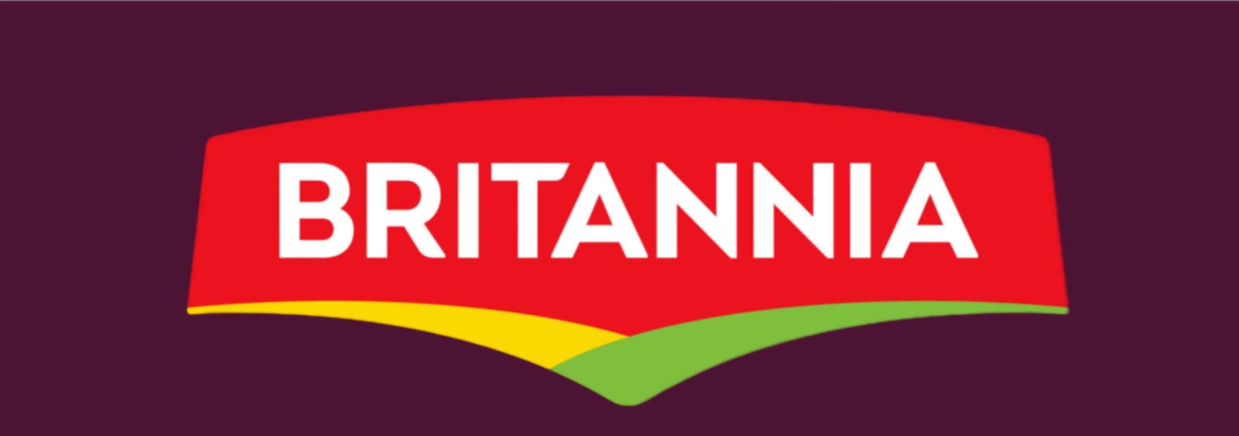
BRITANNIA

Slide 2
Comprehensive digital marketing project Work on “ Britannia “
Team Details
CHINTU NIRANJANI (TEAM LEADER)
MANEM BHARGAVI (TEAM MEMBER)
KOTA SIRISHA (TEAM MEMBER)
SADU HEAMALATHA (TEAM MEMBER)

Slide 3
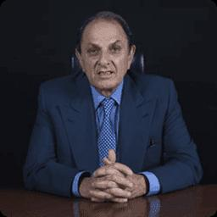
HISTORY OF BRITANNIA
Britannia company was founded by ”Nusli Wadia” in 1892
by a group of British Businessmen
with an initial investment of ₹295
Our businesses are in bakery, dairy,
and adjacent snacking categories and
our operations span over 80 countries
In the world initially biscuits were
manufactured in a small house in central
Kolkata Later the enterprise was
Acquired by the Gupta brothers, mainly
Nolin Chandra Gupta, an attorney.

Slide 4
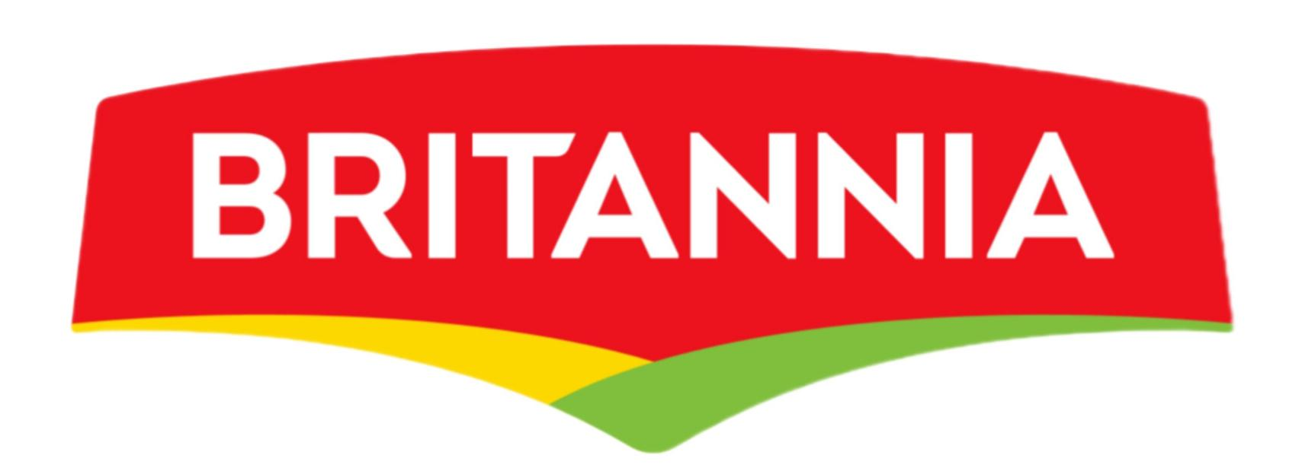
Products of Britannia
D . Cakes
Veg cakes
Bar cakes
Chunk cake
Nut and raising romance
Muffils
Biscotti
E . Rusk
Bermium bàke
Biscuit
Good day
Crackers
Marigold
Tiger
Milky biscuits
Bourbon
Nutri gold
Little heartsLittle hearts
B . Breads
Whole white breads
White sandwich breads
Bread assortment
Daily breads
C . Diary
Cheese
Fresh diary
Accompaniment

Slide 5
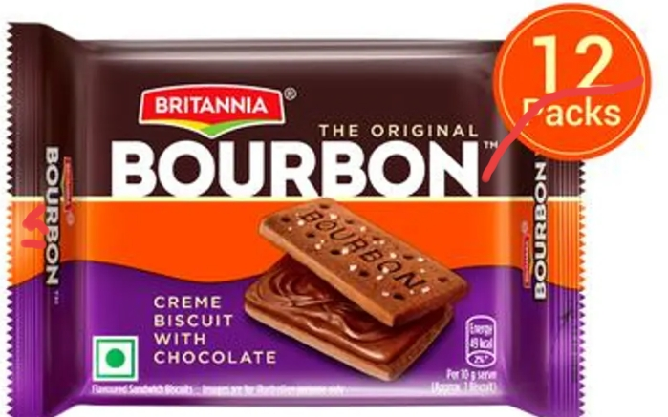
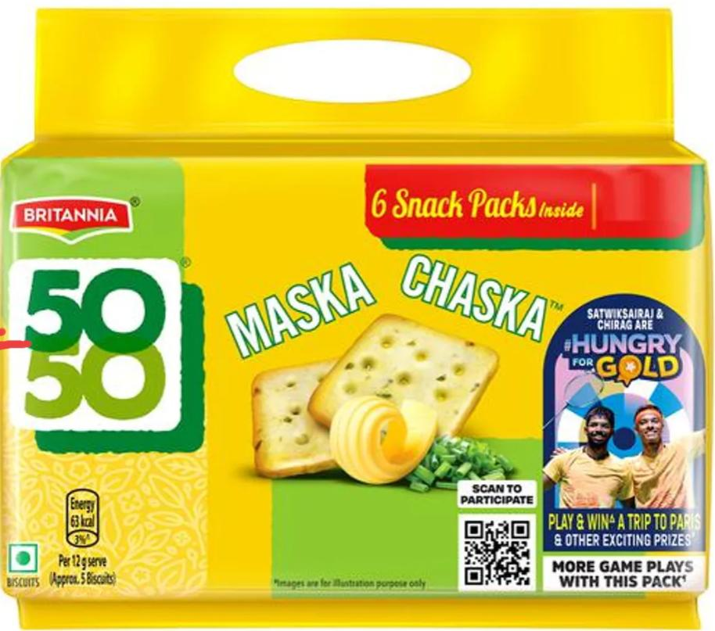
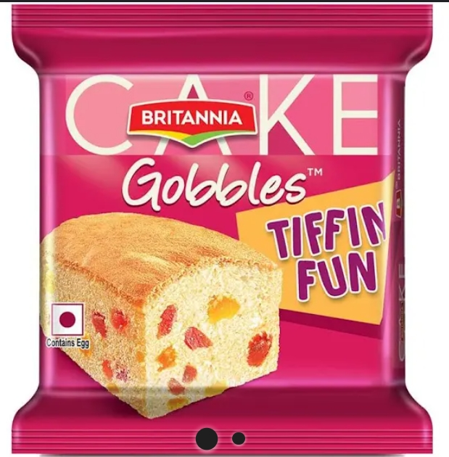
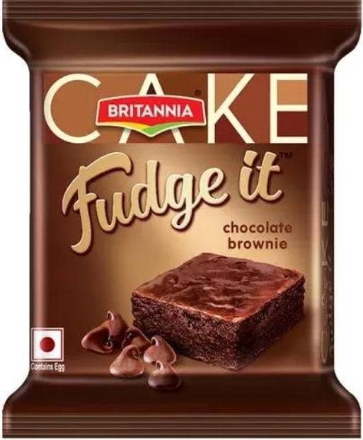
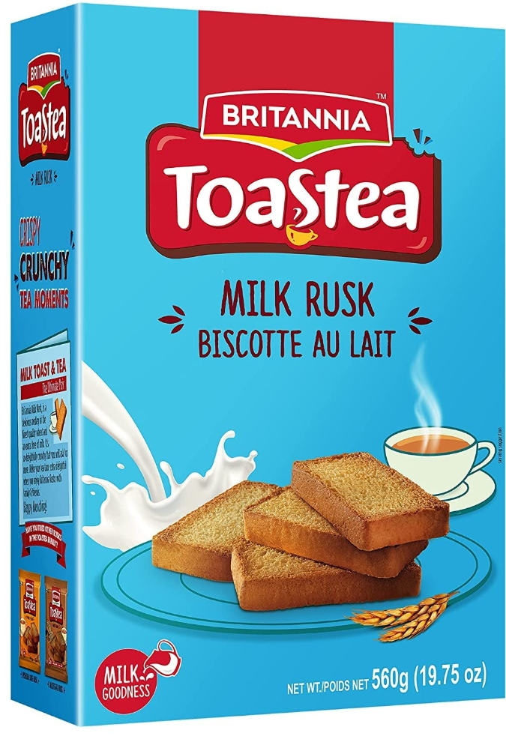
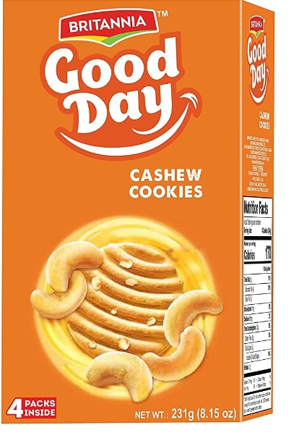
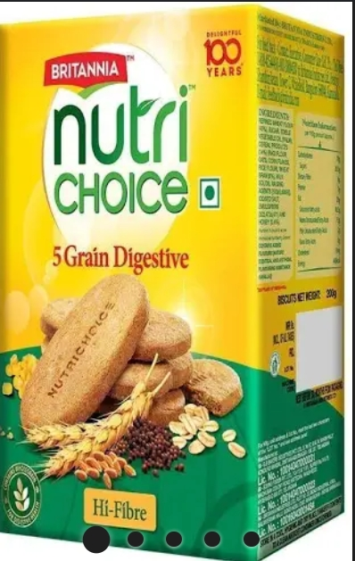
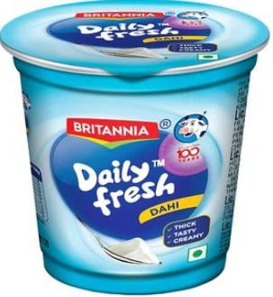

Slide 6
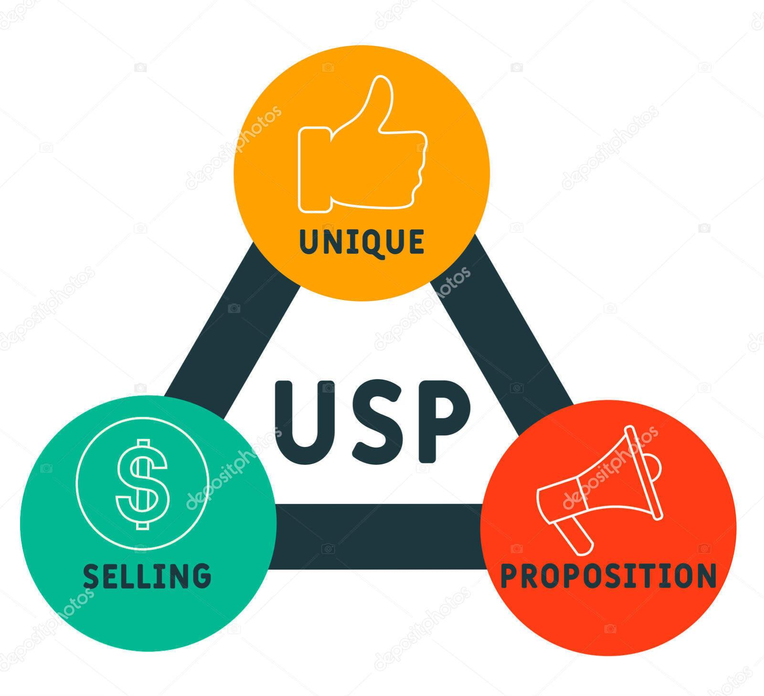
Mission / values & usp
Mission ; “Britannia’s mission is to provide financial services with the traditional banking values of quality services and knowledge of its clients,.”
Unique Selling Proposition (USP); Britannia’s unique selling proposition (USP) lies in its commitment to delivering quality, taste, and innovation while staying true to its heritage.

Slide 7
Brand tone & kpi
Brand tone ; The brand’s new positioning of Exciting Goodness espouses the increasingly relevant idea of balance. The new logo celebrates this beautiful balance between the two fundamental choice drivers – Wellbeing and Excitement as also between accessibility and premium.
Sale growth ; In fiscal year 2023, the net sales value of Britannia Industries Limited reported a growth rate of 15 percent. This was a significant increase compared to the previous financial year. Britannia is one of India’s oldest food companies that manufactures biscuits, bread, cakes, rusk, and dairy products.
Customer satisfaction ; It is observed from that majority of the Respondent belongs to Preference of Biscuits chosen in Britannia products of Milk bikis (33.6%), followed by Good day (21.7%), Bourbon (21.7%), Marie Gold (16.6%), and Little Hearts (6.4%).
Market share : Biscuits. As of 2023, about 80% of Britannia’s annual revenue comes from biscuits. Britannia has an estimated market share of 33% in the organised biscuits market in India. The company’s factories have an annual capacity of 433,000 tonnes.
,

Slide 8
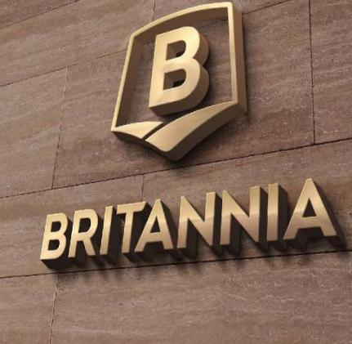
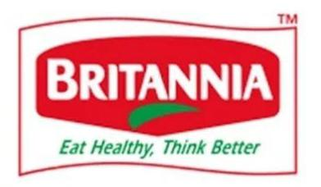
Logo :
Red colour; denotes energy and vitality
White colour ; denotes purity
Green colour ; stand for nutrition and freshness
Vision and mission ;
Deminate the food and beverage market in India with a distinctive range of “ tasty yet healthy” Britannia brand
Everything person in India should be a Britannia consumer

Slide 9
Competitors ; Parle Glucose also known as Parle-G (G for Genius) is
manufactured in India by the Parle Products which is one of the oldest brand names
and the biggest selling biscuits in India.
Market Share ; Parle-G has a market share of 70% in the biscuit industry in India
followed by Britannia, Tiger with 17-18%, and Sun feast of 8-9% share.
Sales/Profit Trend :More than 50% of the company’s turnover is estimated at
around Rs 20 billion. It has started expanding to areas such as Western Europe, USA,
UK, UAE and Canada.
Target Market : Pale has a target market which is focused in India, consisting of
people of all category groups such as children, teenagers, family members and even
old aged people as it is a popular biscuit eaten during Tea-time snack.

Slide 10
Brand study, competitor analysis & Buyer’s / audience persona
Competitor Analysis; Britannia’s competitors and similar companies include Tata Consumer Products, Ainsworth Pet Nutrition, Scandi Standard and Lotus Chocolate. Britannia is India’s Foods Company While Parle dominates in terms of value and volume, this year it saw a surprising growth of Britannia which surpassed Parle by 0.5%. Britannia’s market share was a little over 28% in value terms in April this year, while Parle’s value share during the month stood at a little over 27.5%.
Competitor 1;
Competitor 2;
Competitor 3;

Slide 11
Competitor 1: ”Tata consumer products “
USP ; Our strengths lie in our deep understanding of our consumers in India and in international markets with our iconic market-leading brands and wide consumer reach. We are committed to delivering high-quality, innovative, tasteful and convenient products with goodness at its core.
Online communication:Tata Group has various online communication channels, including its official website, social media accounts, email newsletters, and possibly chatbots or online customer support services depending on the specific businesses within the group.

Slide 12
Strength ‘s :
Mutual Funds Increased Shareholding in Past Month Consistent Highest Return Stocks over Five Years – Nifty50
Weakness ;
PE higher than Industry PE Poor cash generated from core business – Declining Cash Flow from Operations for last 2 years
Opportunity’s :
Companies with Upcoming Results Expensive Performers (DVM) High Momentum Scores (Technical Scores greater than 50)
Threats :
Promoter decreasing their shareholding PEG greater than Industry PEG High PE (PE > 40)

Slide 13
Competitor 2 : “Dabur”
UPI’s ; Dabur provides a unique platform by offering products that encapsulate the goodness of Ayurveda and are in sync with consumer preferences Dabur’s positioning on the ‘health and wellness’ platform, backed by its ayurvedic, natural and herbal (ANH) image is very progressive.
Online communication : Dabur, like many companies, utilizes online communication channels such as its official website, social media platforms, email newsletters, and possibly online forums or chat support to engage with customers, share updates, and provide customer service

Slide 14
Strength’s :
Market share
Lower price
Health representer
Website & E-commerce
Weakness ;
Duplicacy
Rules & Regulations
International tooth paste competitors
Opportunities ;
Recent health activity
Demand in foreign markets
International of ayurvedic beverage
Yoga & ayurvedic all over the world
Threads ;
To Many products
Computation from MNC’s
Entrance of local bodies

Slide 15
Competitor 3 ; “ Adf foods”
USP ; Pack and preserve the rich authentic Indian taste in the form of quality products and send it all across the globe ADF Foods (ADF) is a leading manufacturer of prepared ethnic food, offering frozen foods, ready-to-eat (RTE) items such as curries and rice, ready-to-cook (RTC) items, chutneys, sauces, pickles, spices, pastes, dips and milk drinks under its 5 Flagship brands.
Online Communication ; Our wide range of ethnic foods, include Indian, Middle Eastern, Mediterranean and other global cuisines. Our products are suited to, and serve, a vast number of geographies. We reach out to consumers everywhere with our unparalleled network of 180+ distributors spread across 55 countries. From masala pastes to meatless meatballs; parathas to pickles, we are passionate about feeding the world, and have something for everyone

Slide 16
Strength ‘s :
It has a strong and active R&D unit which is continuously engaged in adding new products to its product portfolio. Company has several tie-ups in UK, US, Middle East, Australia, Canada and Asia, to ensure extensive distribution of products.
Weakness ;
High requirement of working capital. Divergent food habits of people in the global market affects demand.
Opportunity ‘s :
Opportunities in terms of expanding their product portfolio Introducing all their brands in all the global markets where they have a presence.
Threats ;
Affordability and cultural preferences of fresh food High inventory carrying cost.

Slide 17
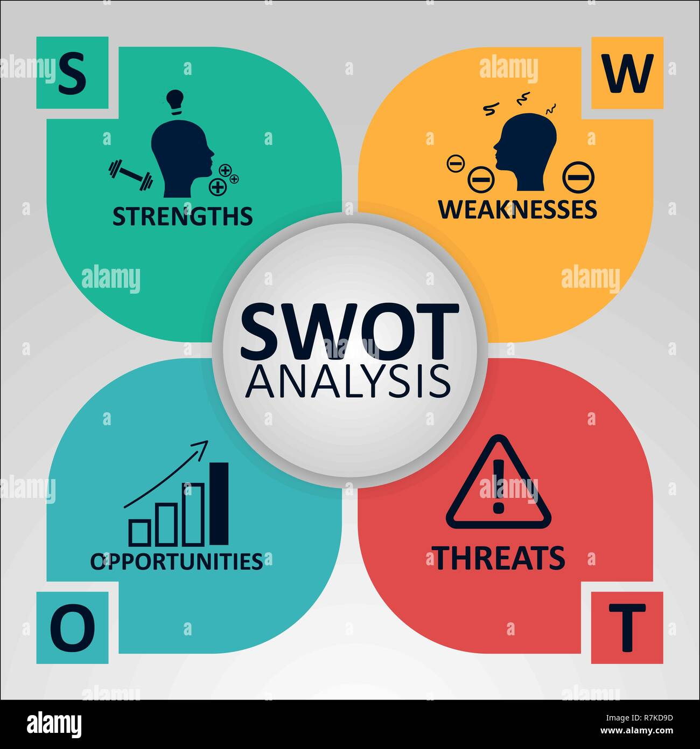
Swot Analysis of Britannia

Slide 18
Strengths :
• Widely Distributed network and accepted by all age groups.
• Innovative products like-Little Hearts, 50-50 Chakkar, and Nice Time.
• Celebrity endorsements – Sachin Tendulkar, Aamir Khan.
• The Brand Slogan of Britannia “Eat Healthy Think Better” is the key asset of
the firm.
• It is available in various different forms of packages.
Weaknesses :
• Faces stiff competition from their rival Parle and Nestle on the basis of Price
and Distribution channels.
• The industry and technology requires high investments.
• As too many different types of brands enter the market, they might lose focus.

Slide 19
Opportunities :
• People are willing to try newer variants and hence it satisfies the taste buds by
its newer variants.
• It generates employment opportunities.
• As consumers are very concerned about their health, it helps them to
strengthen brands NutriChoice, Milk Bikis, and Tiger biscuits.
• Competition increases.
• This helps to enhance mergers.
Threats:
• They might sometimes be unable to utilize all the resources efficiently.
• They may provide poor quality of biscuits for more profits.
• As there are a number of biscuits in the existing market, they have large
number of challengers.
• Consumer demands may alter impulsively.
• Government might come up with new restrictions without notices.

Slide 20
seo & keyword research
SEO Audit ; Britannia optimizes the website’s content and structure to improve its visibility in search engine results.
Keyword Research; Our team is involved in developing sustainable packaging solutions, reducing food waste, and developing products that are environmentally friendly. The team played a focal role in the Company achieving ‘plastic waste neutrality’ across its operations in the country in June 2022.
On page optimisation : Britannia optimizes their website’s on-page elements by incorporating target keywords naturally into meta tags, headings, URLs, and image alt tags.

Slide 21
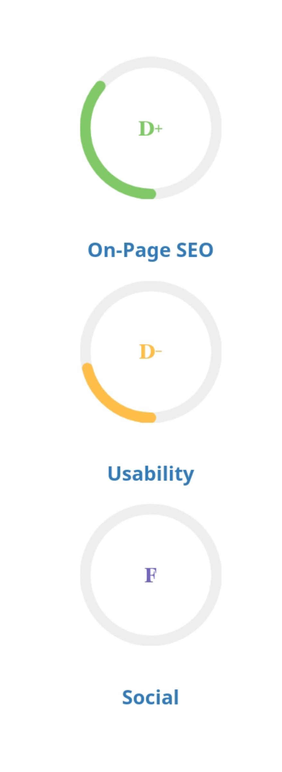
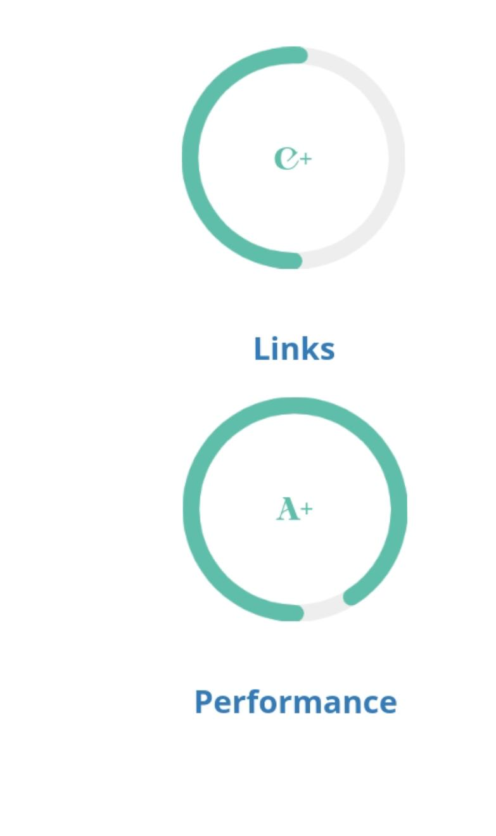
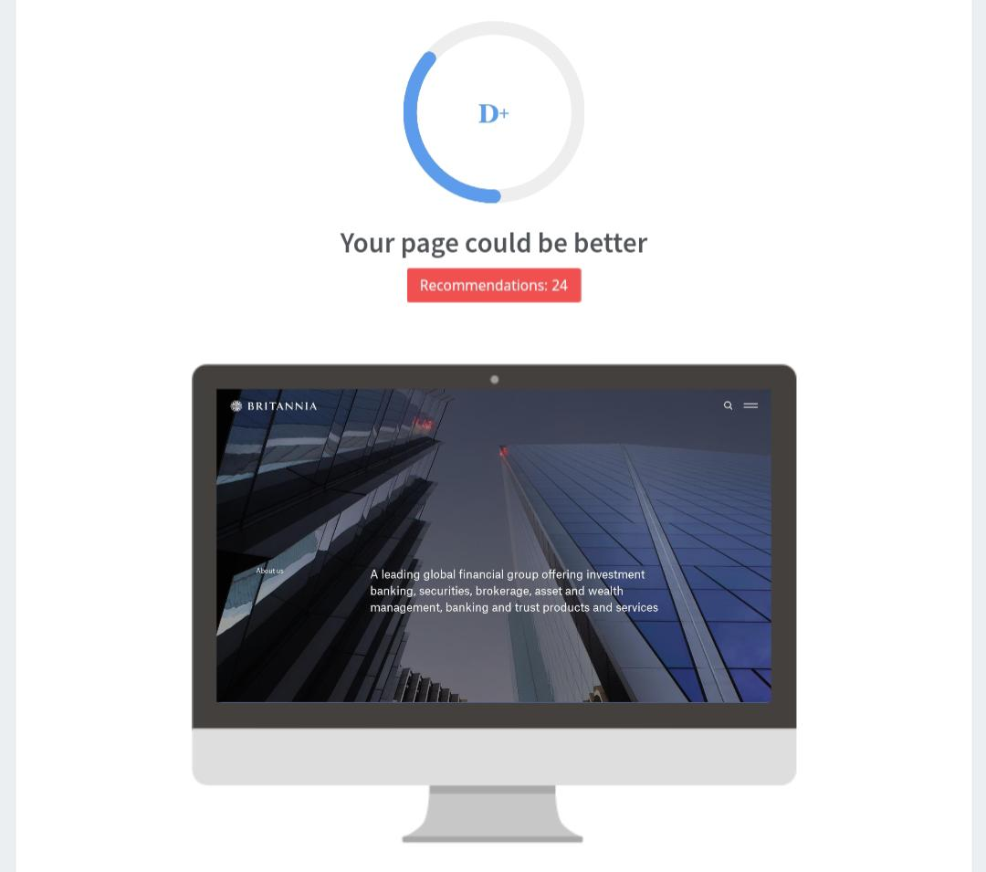
Seo audit
This picture shows the SEO audit of Britannia company
This face shows on fage , seo links usebilities performance and social in the company

Slide 22
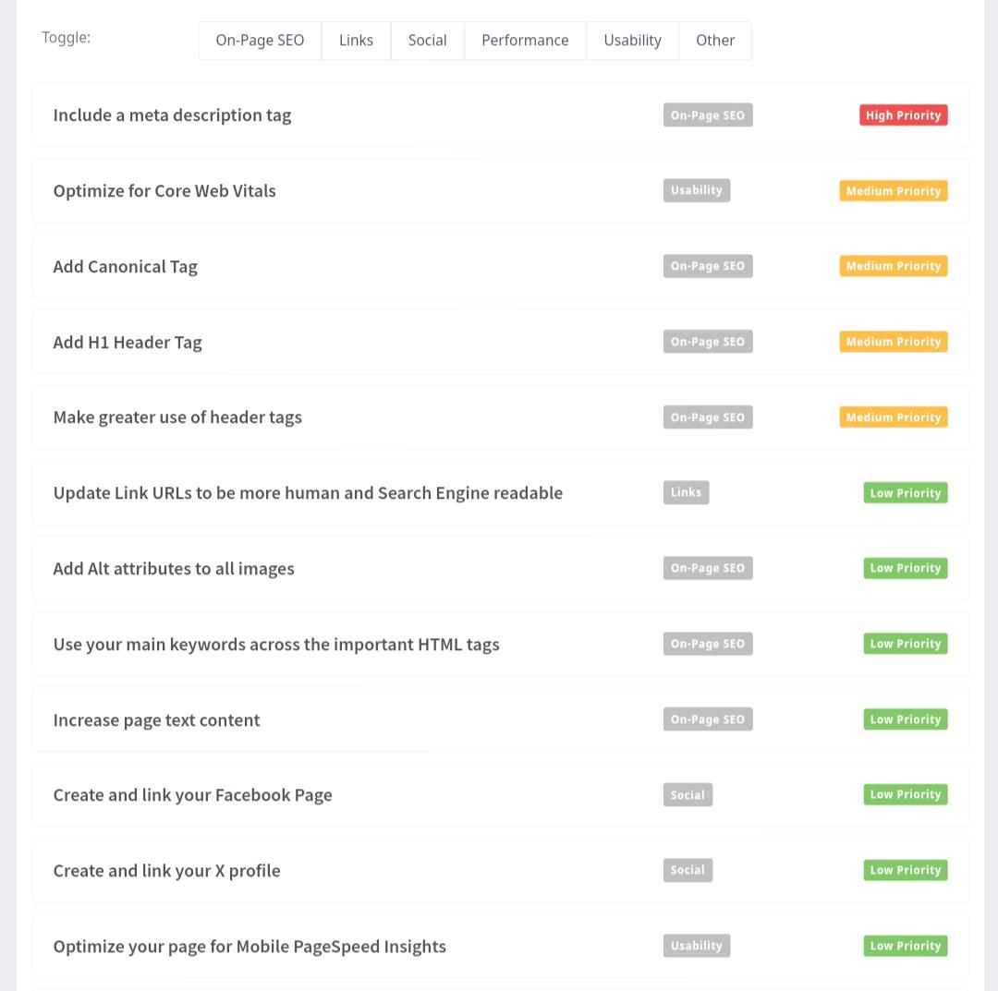
Seo audit
This page contains recommendation of Britannia company and his also a SEO audit of Britannia company

Slide 23
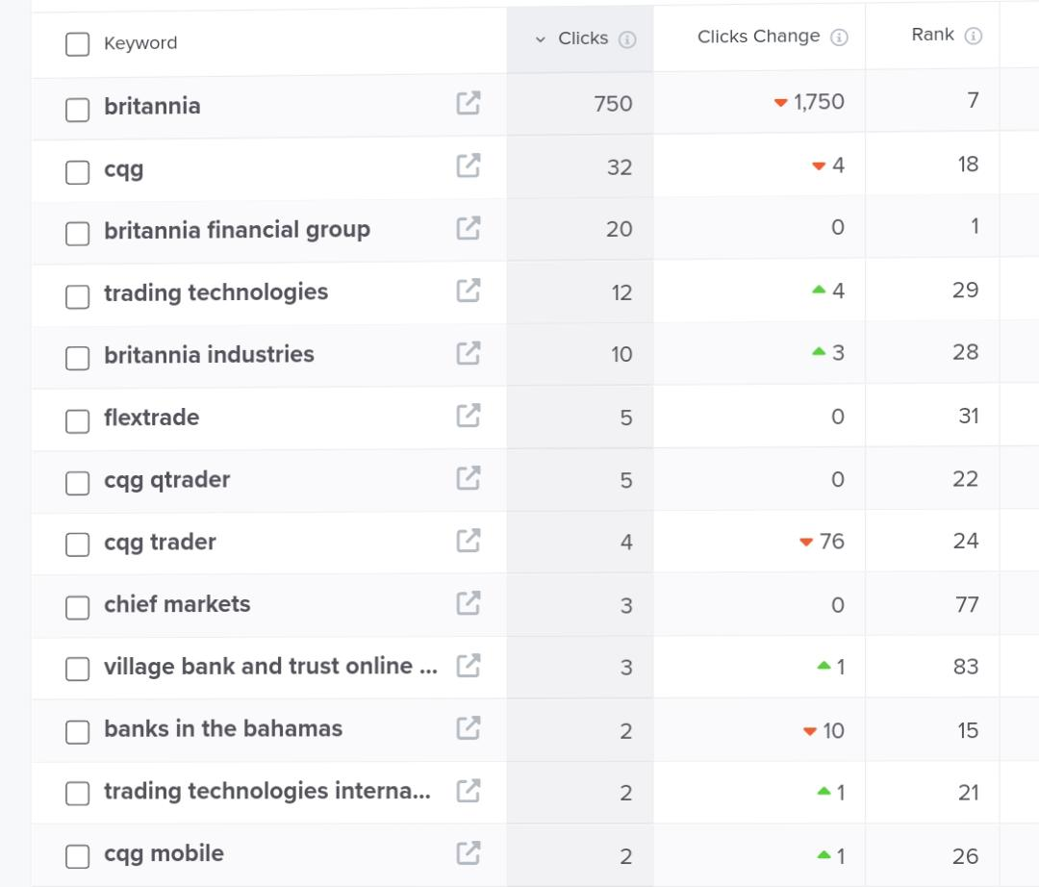
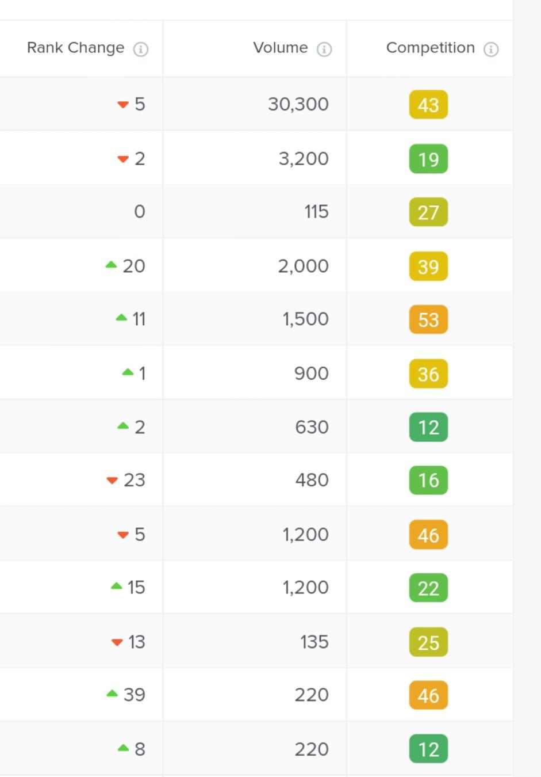
Keyword research
Key objective :
Britannia
Britannia industries
Britannia financial group
Chief markets

Slide 24
On page optimisation
Focus keywords ; The company’s principal activity is the manufacture and sale of Britannia, Britannia financial group, chief markets etc....
Meta title ; The meta title of Britannia company’s b like “Official Website | Britannia Industries Ltd. | Leading Bakery Products Manufacturer”
Meta Description ;Britannia Industries Limited is an Indian multinational food products company, which sells biscuits, breads and dairy products. Founded in 1892, it is one of India’s oldest existing companies and currently part of the Wadia Group headed by Nusli Wadia. As of 2023, about 80% of its revenues came from biscuit products.

Slide 25
Content Idea & marketing strategies
Content idea :Marketing strategy of Britannia and social media campaigns are more focused on connecting taste, nutrition, and moments of life. It has successfully occupied a major market share in the bakery, biscuits, and dairy industries. Britannia has also focused on new product development and promoting nutrition and health.
Marketing strategy of Britannia ; The marketing strategy of a company is an assortment of different elements of the marketing plan. When a company decides to market its products to customers, it does a small exercise called Segmentation, targeting and Positioning (STP) of its customers.

Slide 26
Britannia’s Social Media Strategy
In this era of digitalization, it has become very important for companies to promote themselves on social media platforms. Britannia has been doing its best on Social Media as well as to achieve its communication aims.
Instagram: Britannia has a total of 7,158 followers and they usually post their newly
launched products and creative banners and schemes for different festivals.
Face book: On Face book, Britannia has a total 25,727 likes on their page and they
usually post short advertisement videos and posts, contests.
Twitter: It has 14,700 followers on Twitter. It uses the same creative ideas on
Twitter as on Face book and Instagram..

Slide 27
content creation and curation
Format 1 ; “Instagram post “
Caption: good day Start with good day biscuit
A biscuit a day keeps the bad mood away....
Hashtag; #britannia #cookie #cookies #chocolate #biscate #biski #cookiesofinstagram #food #dessert #cake #baking #foodie #yummy #foodporn #sugarcookies #homemade #cookiedecorating #bakery #love #delicious #cookieart #sweet #royalicing #instafood #royalicingcookies
Post link ; https://www.instagram.com/p/C596blRRW48/?igsh=dmF5bW4xbGhvZmlq

Slide 28
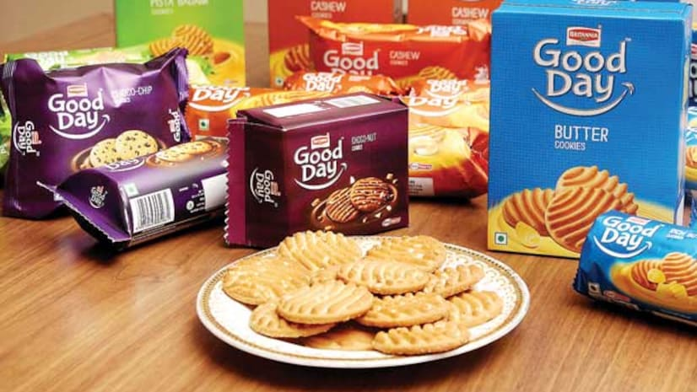

Slide 29
Formate 2 : “Instagram reel”
Captain :
a positive attitude and their sense of Homer go together like biscuit and gravy
Breakfast without biscuits is like a circle without clowns
Keep clam and eat biscuits
Hashtag :
#cookie #cookies #chocolate #cookiesofinstagram #food #dessert #cake #baking #foodie #yummy #foodporn #sugarcookies #homemade #cookiedecorating #bakery #love #delicious #cookieart #sweet #royalicing #instafood #royalicingcookies
Reel link : https://www.instagram.com/reel/C594JCNxwqs/?igsh=ZGYyZmRtb3N4eXdl

Slide 30
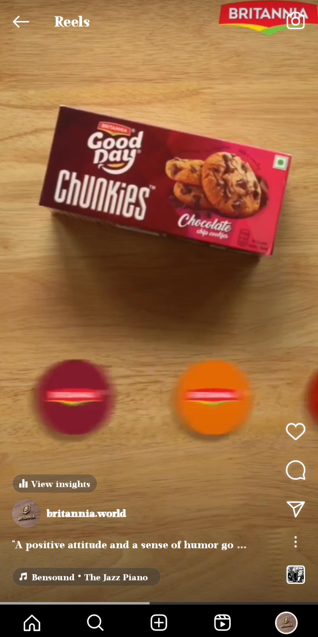
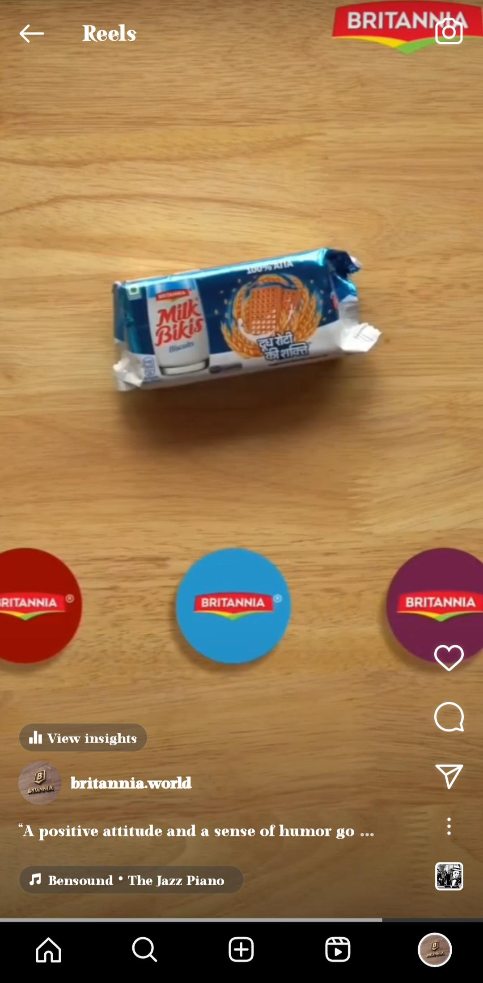
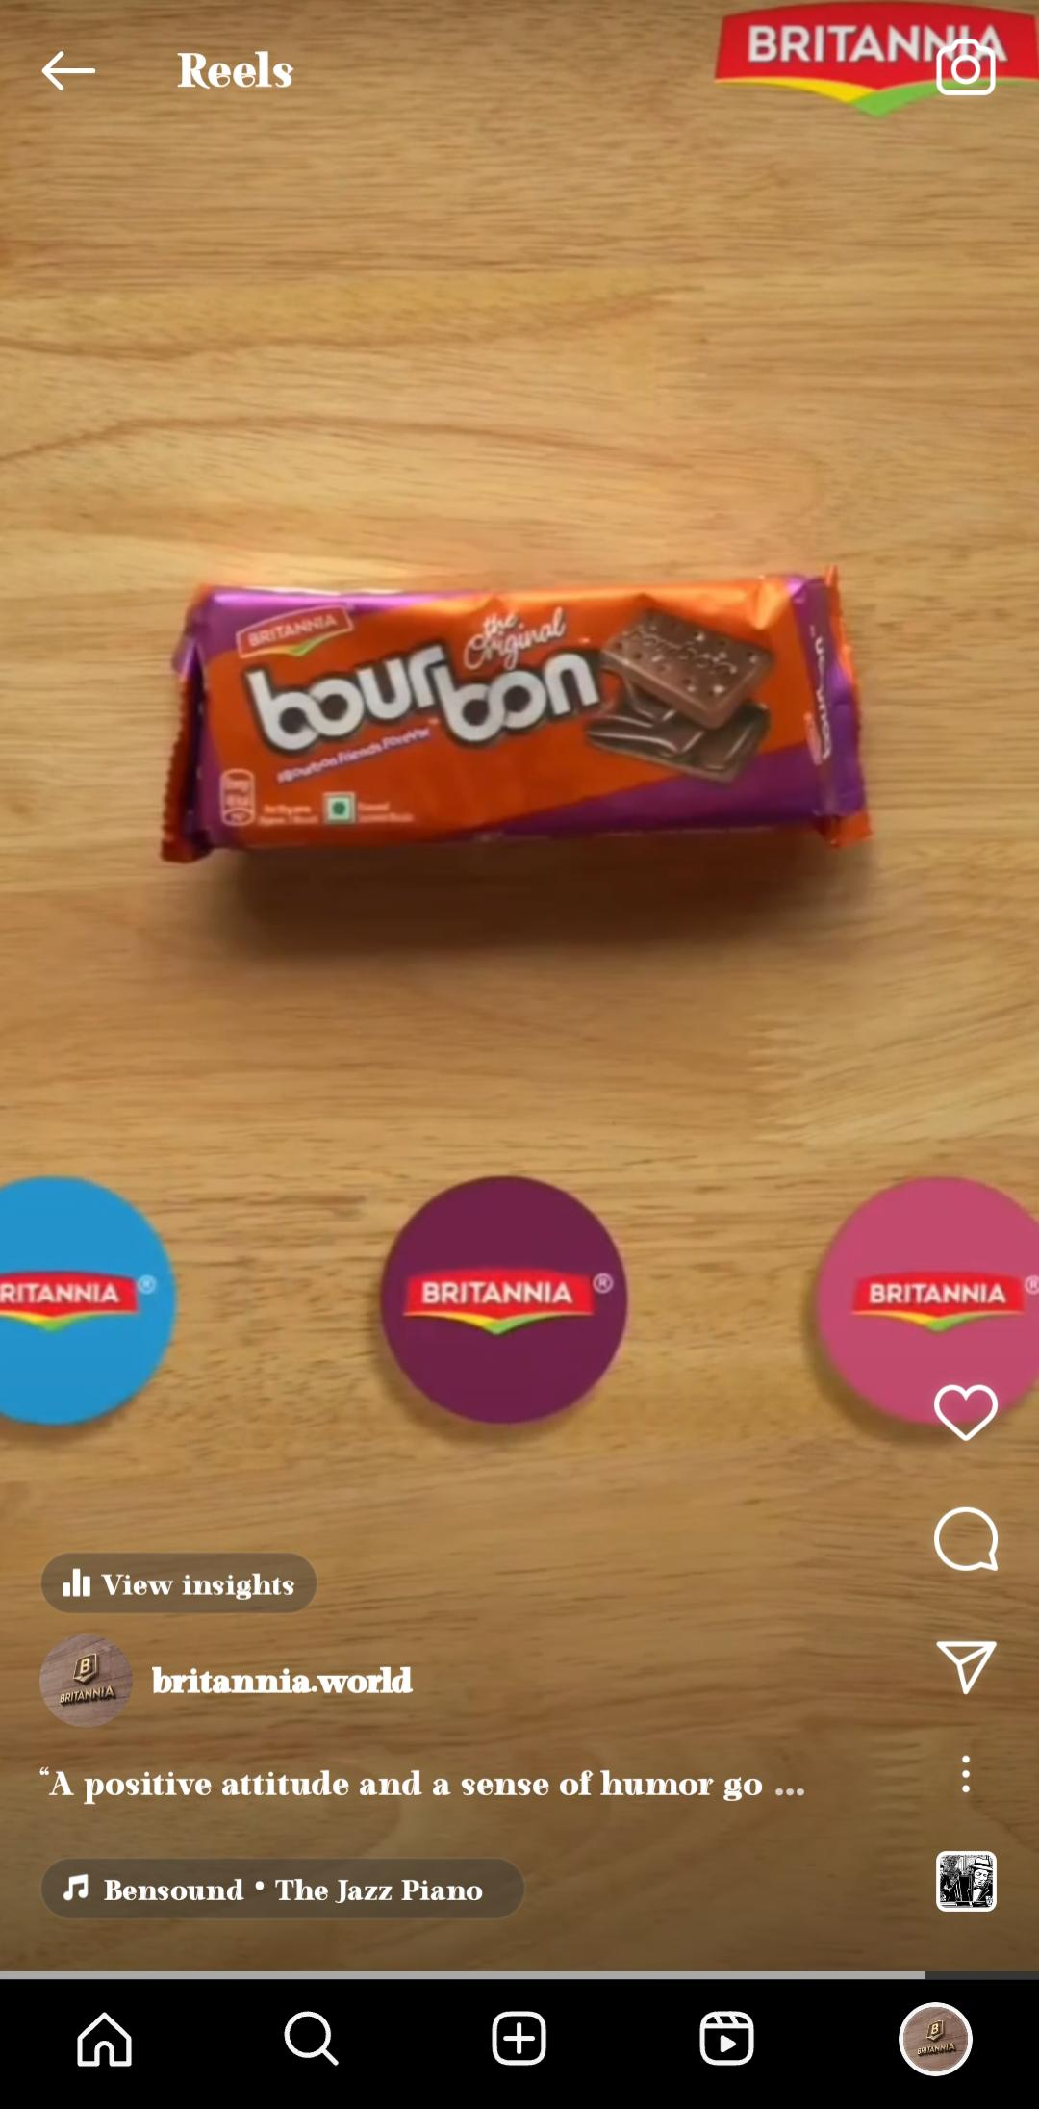

Slide 31
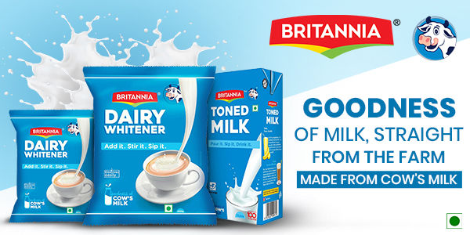
Formate 3: “ Instagram post “
Captain : the Britannia dairy milk gives a strength and healthy
Hashtags : #britannia #dairymlk #britanniadairy #good #homemade #cowmilk #goodqulity #dairy #britannia
Post link :https://www.instagram.com/p/C596__Dxv8f/?igsh=MXNqNXR1M3UwaWg5NA==

Slide 32
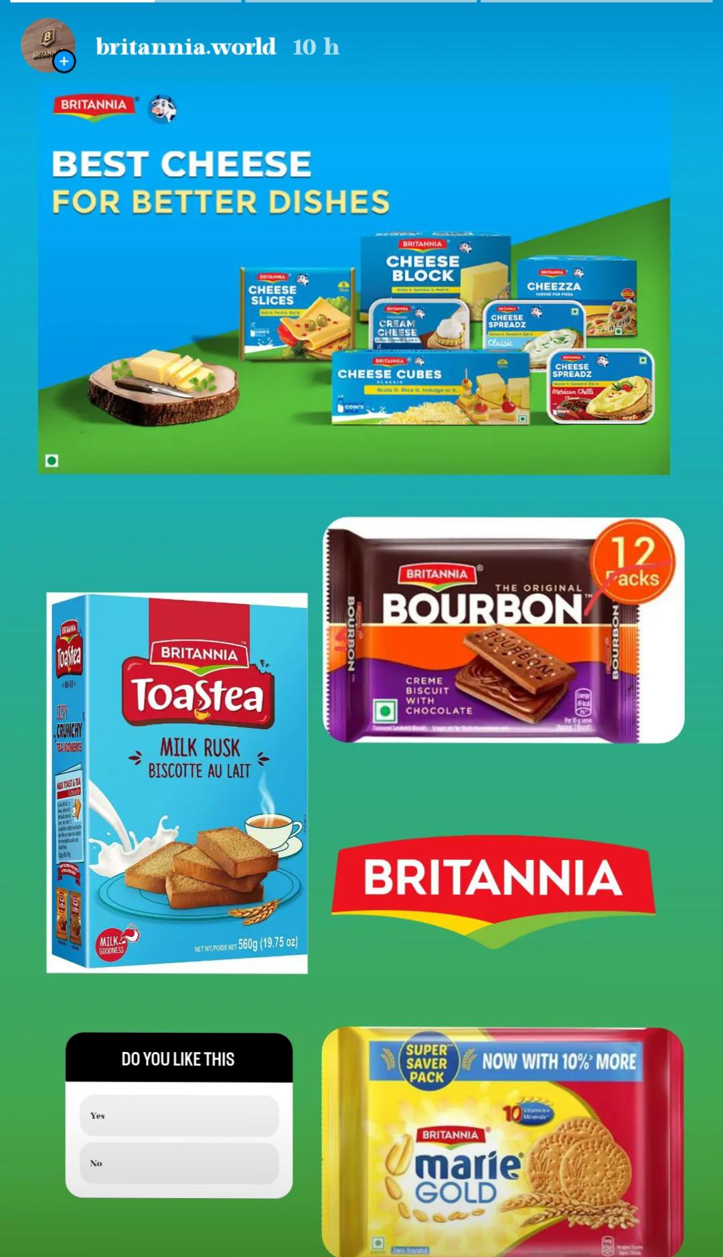
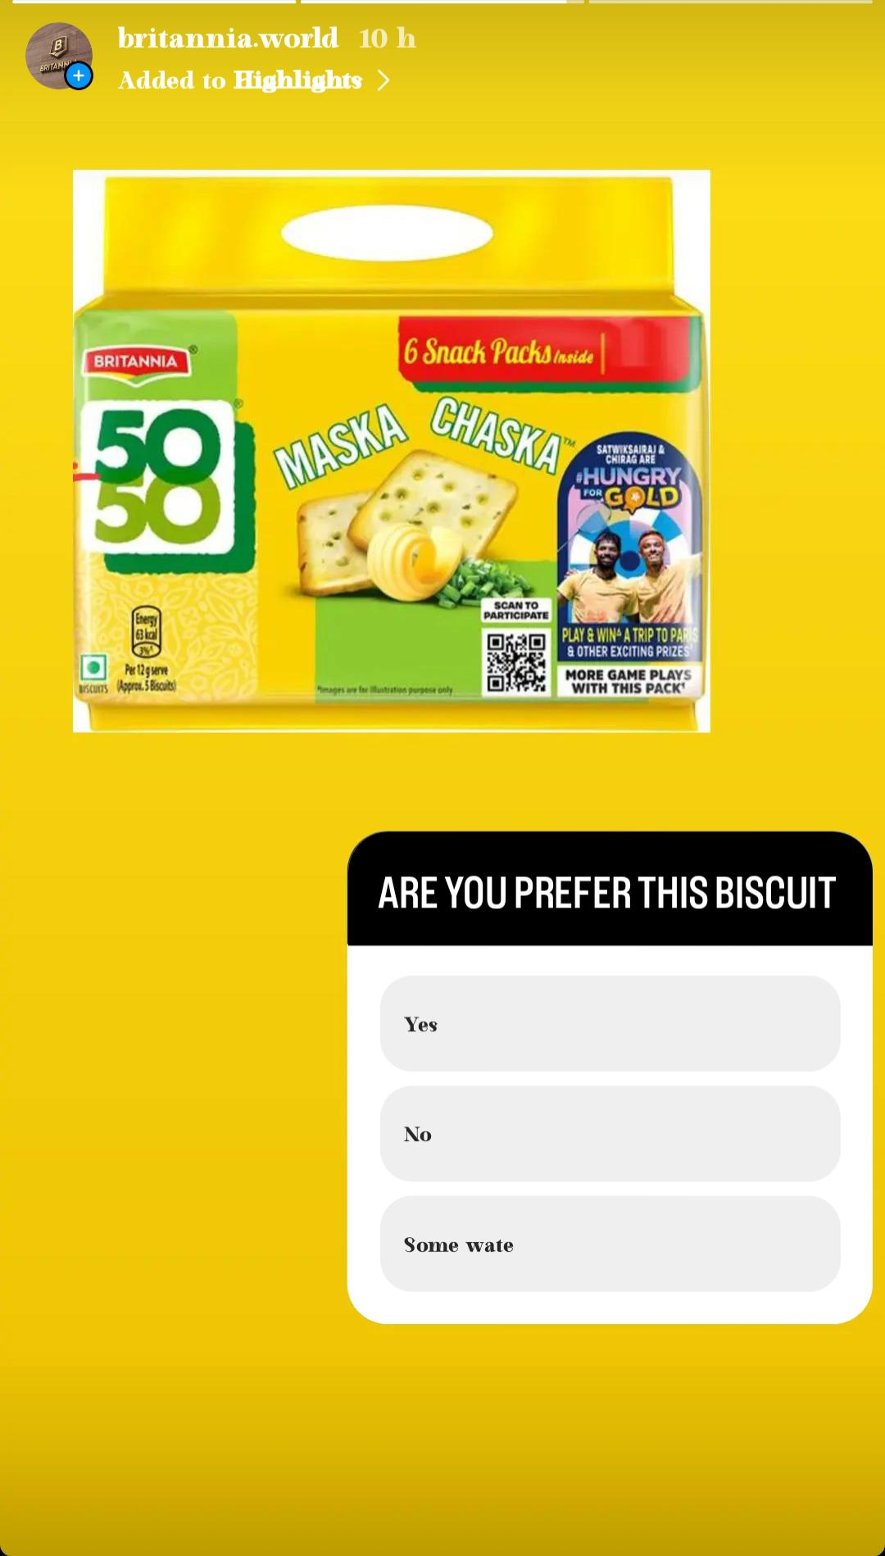
Instagram story
Screenshot of Instagram story ;
Instagram profile link https://www.instagram.com/britannia.world?igsh=Y2JoMmRrMjFiY2J4

Slide 33
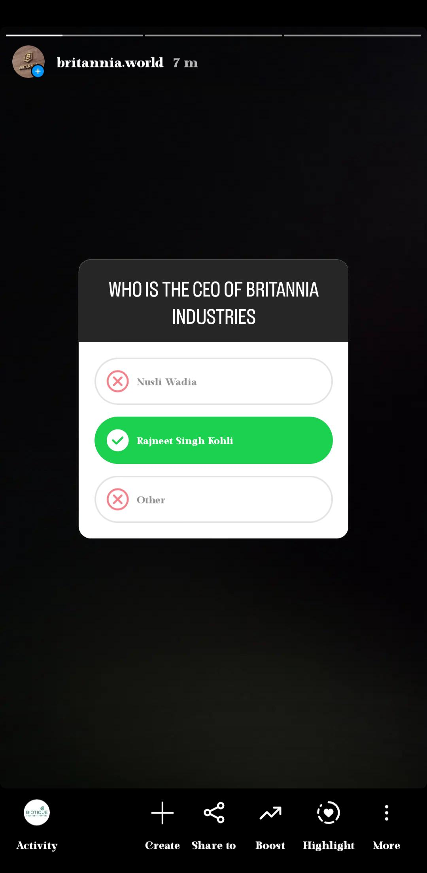
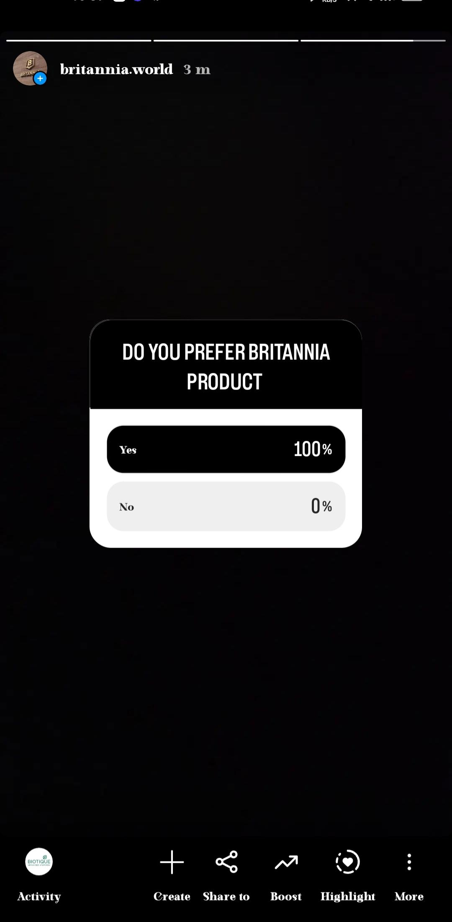
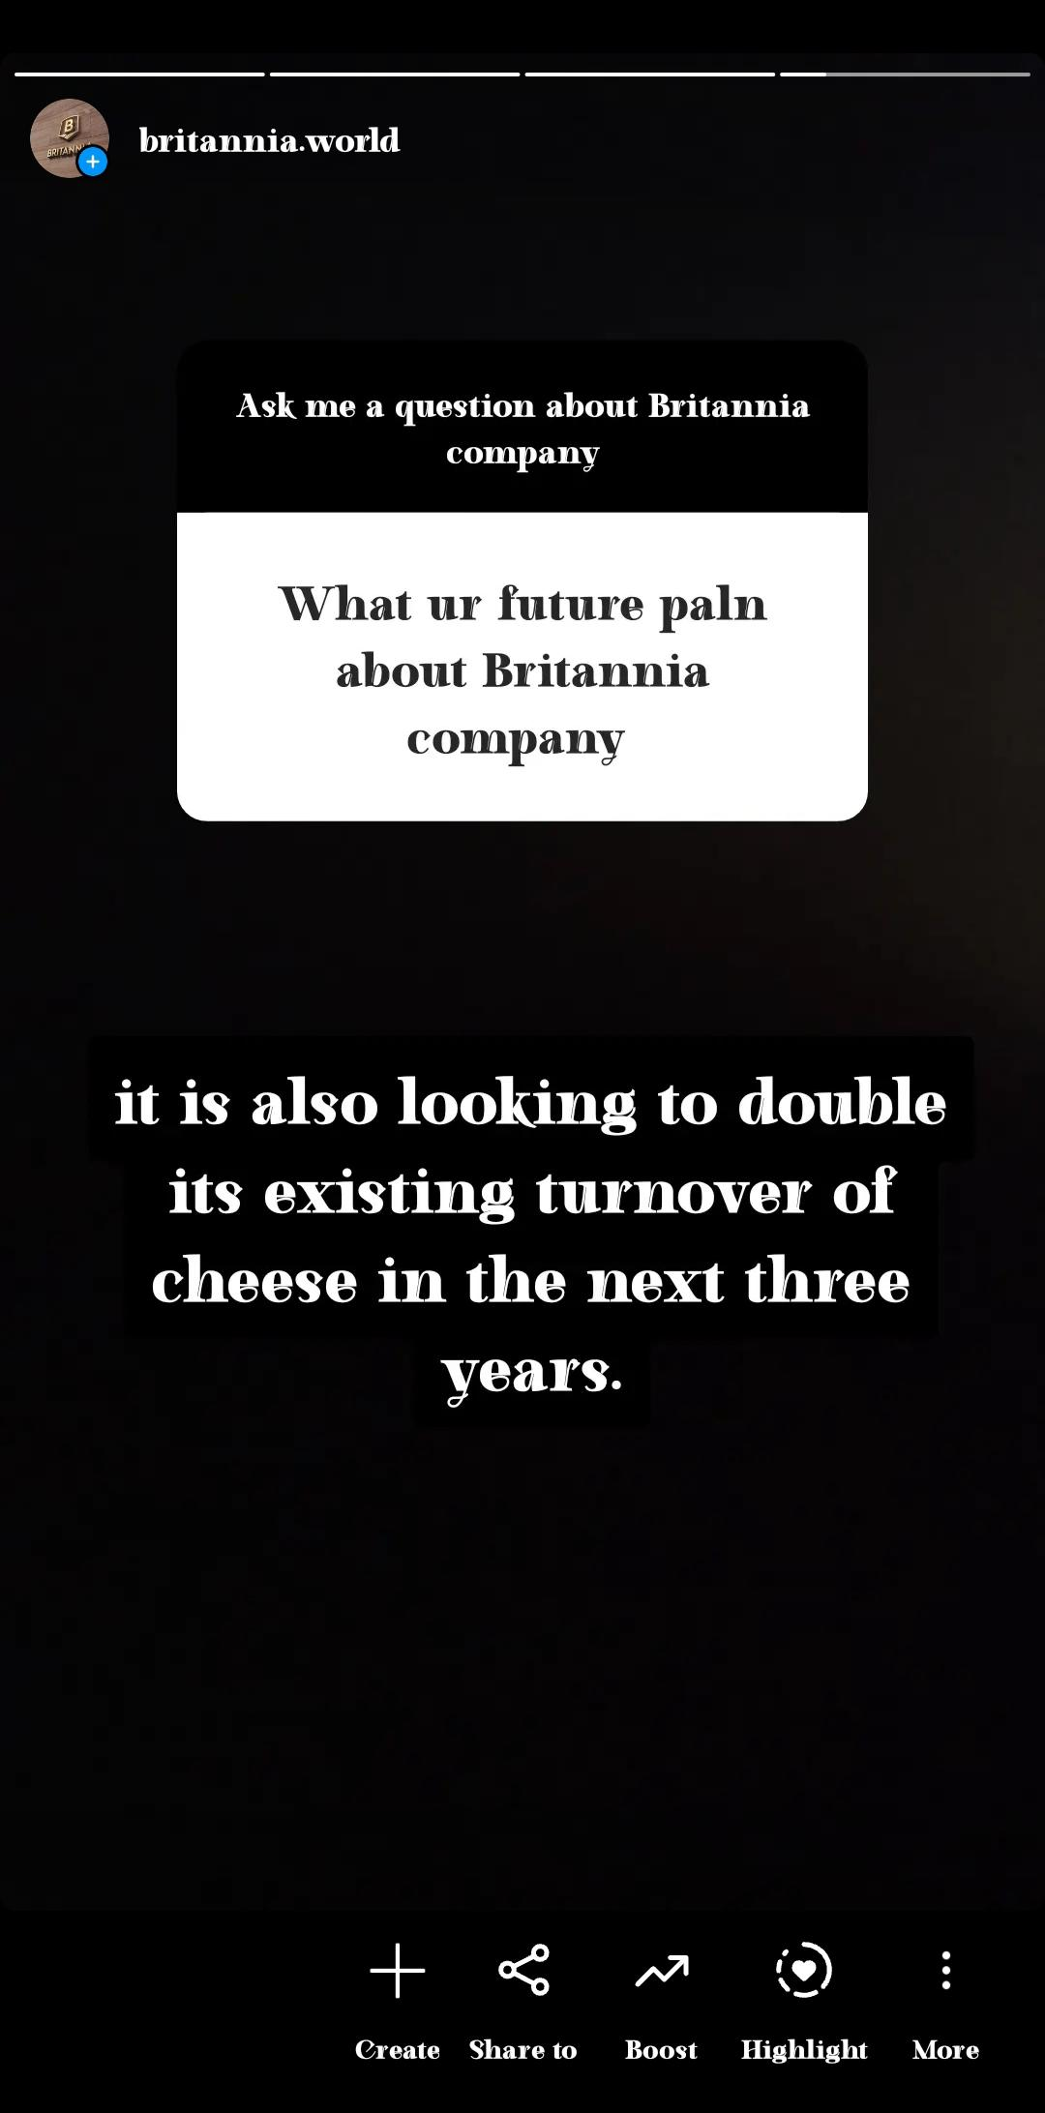
Instagram story’s

Slide 34
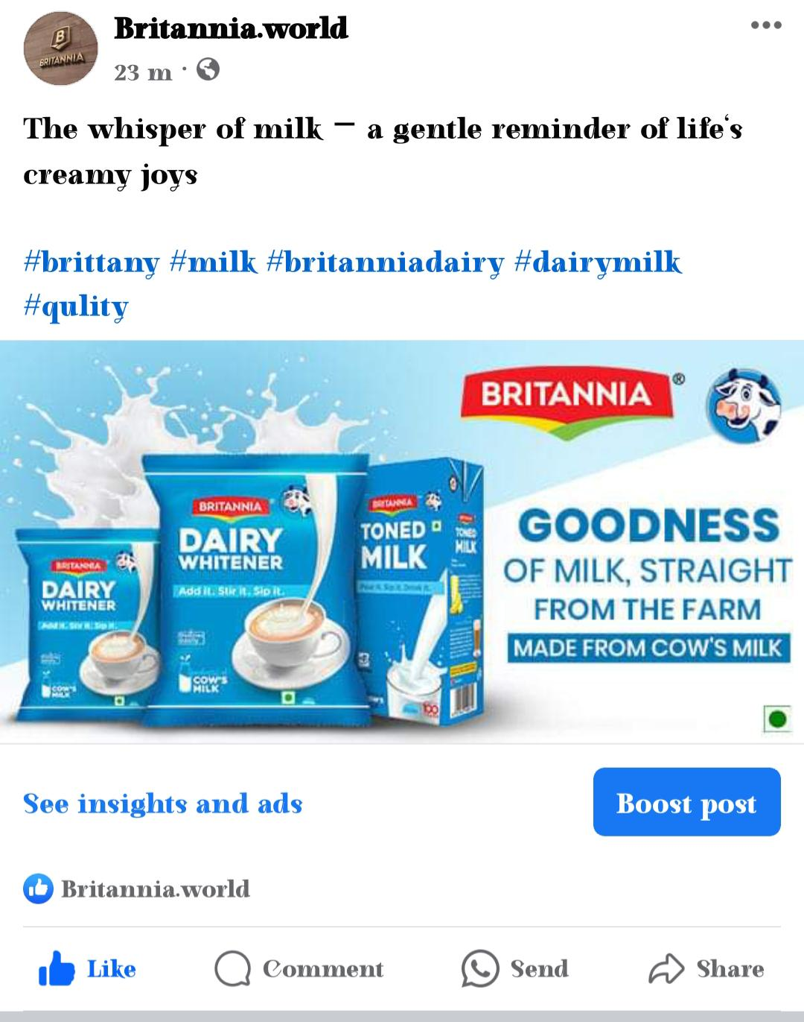
Facebook profile link ; https://www.facebook.com/profile.php?id=61558461191550&mibextid=ZbWKwL
Facebook post link :
https://www.facebook.com/share/p/tVaHJBQKGA8WtFbj/?mibextid=oFDknk

Slide 35
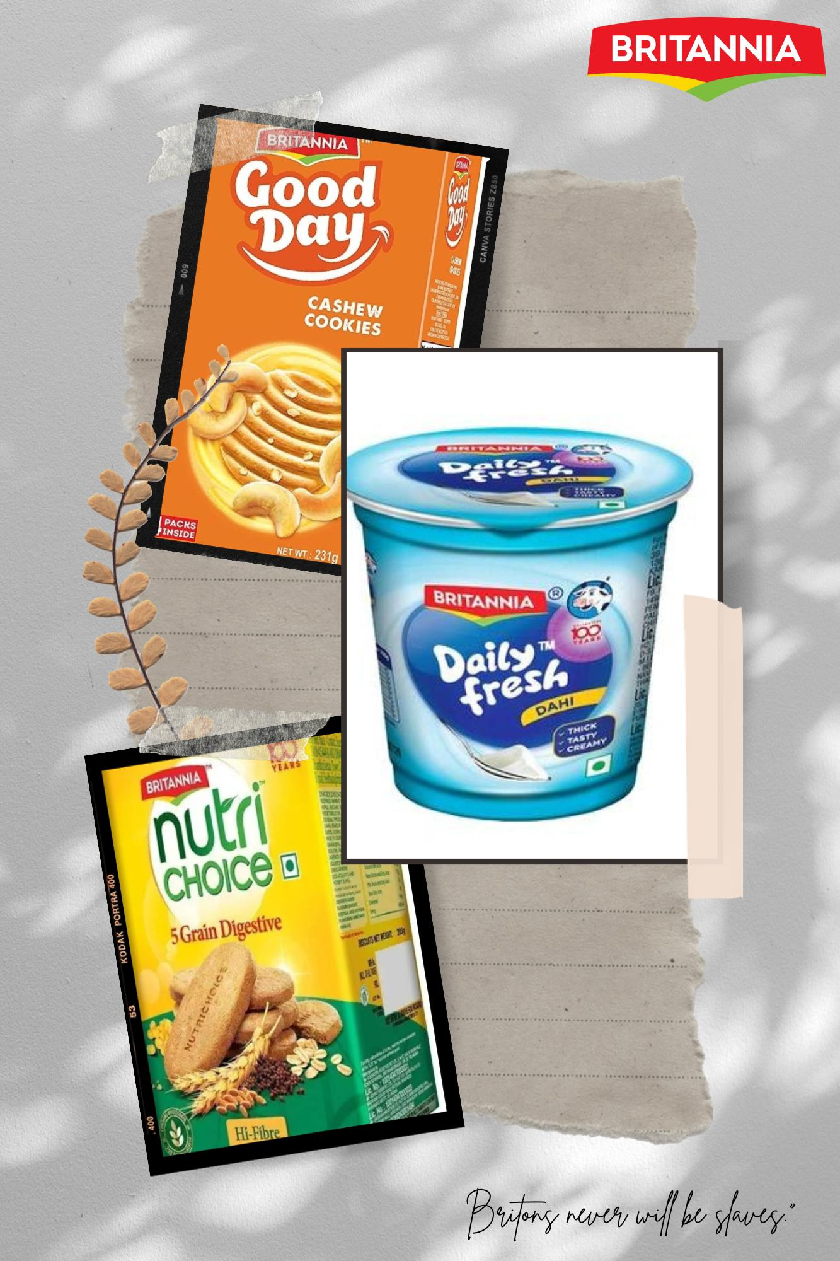
POSTER USING CANVA APP

Slide 36


